Slide 1
Unit 2: Information System Building Block

Slide 2
Introduction
An information system is the main tool that serves the goal of an organization.
From a user’s point of view, an information system is considered as a processing system that manipulate data in forms and reports, from a manager’s point of view, an information system is considered as a tool to create strategic plans and competitive edge and from a developer’s point of view, it is considered as a system developed by programming languages, networking technologies and databases.

Slide 3
The Product Information System
Most organizations are served by a collection of information systems that support various functions.
Two types of information system
Front Office Information
that support business functions that facilitate services to the customers
Back office information system
that support internal business operations as well as interact with suppliers.
Both the front office information system and the back office information systems feed data to management information systems and decision support systems that support management needs of the business.

Slide 4
The Product Information System
Most information systems communicate with customers and suppliers using the electronic commerce technology, customer relation management (CRM) and supply chain management (SCM) applications.

Slide 5
A framework for system development architecture
Any information system is built with the base of certain architecture like the database architecture, application architecture, network architecture and the software architecture.
The information system architecture provides a foundation for organizing the various components of any information system that we are trying to develop.
The system development architecture can be viewed from different perspectives.
From the viewpoint of the owner
From the viewpoint of System designer

Slide 6
A framework for system development architecture
From the viewpoint of the owner, the goal oriented perspective of an information system include
The goal to improve the business knowledge
The goal to improve business processes and services
The goal to improve business communication and collaboration

Slide 7
A framework for system development architecture
From the system designers’ perspective, the information system should focus on
The database technologies that support the business data and knowledge
The software technologies that automate business process and service
The interface technologies that support business communication and collaboration

Slide 8
Based on these factors the building blocks of an information system can be categorized as
Knowledge Building Blocks
The business knowledge is derived after refining and processing the data and information
The system owner may be interested in those information that adds new business knowledge to make intelligent business decisions that support the organization’s mission and the goals.
The system designer is more concerned with the database technology and the interface technology to be used.

Slide 9
Based on these factors the building blocks of an information system can be categorized as
2. Process Building Blocks
The fundamental goal of an information system is to improve the business and services processes.
The system owners are more interested in the reports of high level business functions like sales, services, manufacturing, shipping, receiving and accounting.
Similarly the system users are more concerned with the work that must be performed to provide responses to the business events like sales, inventory, purchases etc.

Slide 10
Based on these factors the building blocks of an information system can be categorized as
3. Communication Building Blocks
The common goal of an organization is to improve the business communication and the collaboration between employees and other core elements.
Information systems should provide effective and efficient communication interface to system users to promote teamwork and coordination of activities.
The information system must provide a medium to communicate with other information systems available in an organization.
A system user’s view of communication is more concerned with the inputs and outputs of the system. The input and the output represent how the information system interact with users, employees, customers and other businesses.

Slide 11
Network Technologies and the IS building blocks
Most information systems developed nowadays are built considering the use of computer networks. The same information system is run on multiple computers across an organization on the foundation of computer networks.

Slide 12
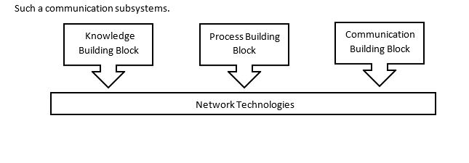
Network Technologies and the IS building blocks
Organizations may use an intranet to support the communication between processes and various networking technologies may be implemented to create

